Slide 1
AAT(TECH TALK)
DESIGN AND ANALYSIS OF ALGORITHMS
20955-A-1206
MOHAMMED ADNAAN UDDIN
INFROMATION TECHNOLOGY (SECTION-A)

Slide 2
TOPIC
Algorithm for Flow Shop Scheduling and Analyze algorithm

Slide 3
INTRODUCTION
In a flow shop scheduling model, each job must be processed on a set of machines in identical order
The goal is to determine the job sequence to optimize a certain predetermined objective function
At any given time, each machine can process at most one job, and each job can be handled by at most one machine, and each job cannot be preempted by the other jobs.

Slide 4
INTRODUCTION
Flowshop scheduling problems widely exist in industrial production and mechanical manufacturing.
Most of extensions of the flow shop scheduling problems are NP-Hard and few of them can be solved optimally in O(nlogn).
The proposed methods to solve flow shop scheduling problems can be classified as exact algorithm such as Branch and Bound and Heuristic algorithm such as genetic algorithm.

Slide 5
The Modified GS Algorithm
Gonzalez and Sahni presented the GS algorithm to solve the flow shop makespan problem. Based on its idea, a new heuristic named modified GS (MGS) algorithm is presented to deal with the flow shop makespan problem with release dates
The MGS Algorithm
Step 1. Divide the m machines into m − 1 groups.

Slide 6
The Modified GS Algorithm
Step 2. For each machine group g = {i−1, i}, i = 2, 3, . . . , m, whenever machine i − 1 becomes idle or new jobs arrive, process the available jobs by Johnson’s rule (i.e., first schedule the jobs with pg(1, j) < pg(2, j) in order of nondecreasing pg(1, j) and then schedule the remaining jobs in order of nonincreasing pg(2, j), where pg(k, j) denotes the processing time of job j in group g on machine k, k = 1,2); if no job is available, go to Step 3.

Slide 7
The Modified GS Algorithm
Step 3. Wait until a job arrives and go to Step 2. If all the jobs have been scheduled, go to Step 4.
Step 4. Terminate the program and calculate the objective values Zg of the schedules. Select the minimum one as the final solution, Cmax = mini≤g≤m−1{Zg}.

Slide 8
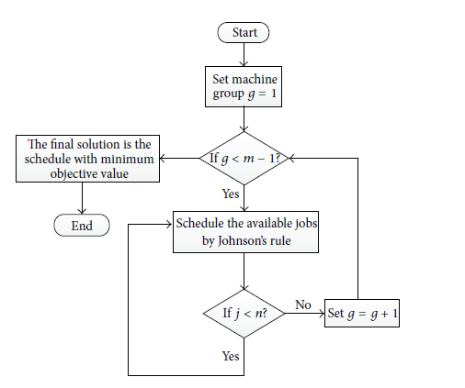
The Modified GS Algorithm
The flowchart of the algorithm

Slide 9
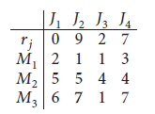
Modified GS example
A flow shop scheduling problem involves three machines, M1, M2, and M3, and four jobs, j1, j2, j3, and j4 with release dates. The release dates and processing times of the jobs are listed below. The objective function of the problem is Cmax. Consider

Slide 10
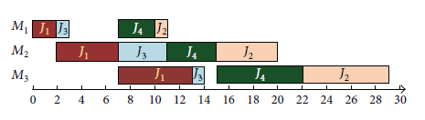
Modified GS example
The final sequence of the MGS algorithm is {J1, J3, J4, J2}. And the objective value is Cmax = 29.The scheduling process is shown below

Slide 11


